Slide 1
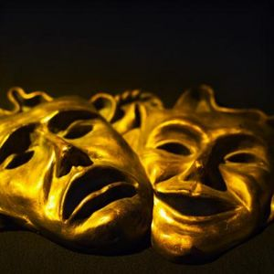
The Elements of greek Tragedy

Slide 2
What is a tragedy?
A tragedy is a drama which, according to Aristotle, depicts the downfall of a basically good person through some fatal error or misjudgment, producing suffering and insight on the part of the protagonist and arousing pity and fear on the part of the audience.

Slide 3
Three Principles of a Greek tragedy
1. “A true tragedy should evoke pity and fear on the part of the audience.”
Pity and fear are the natural human responses to
spectacles of pain and suffering – especially to the sort of pain and suffering that can strike anyone at any time. The effect is that we feel relief in the end through catharsis (purging/cleansing of emotions).
To achieve catharsis is the purpose of a tragedy.

Slide 4
2. “The tragic hero [protagonist] must be essentially admirable and good.”
The fall of a scoundrel or villain evokes applause
rather than pity. Audiences cheer when the bad guy goes down. On the other hand, the downfall of an essentially good person disturbs us and stirs our compassion. As a rule, the nobler and more truly admirable a person is, the greater will be our anxiety or grief at his or her downfall.

Slide 5
3. “In a true tragedy, the hero's demise must come as a result of some personal error or decision.”
According to Aristotle, there is no such
thing as an innocent victim of tragedy, nor can a genuinely tragic downfall ever be purely a matter of blind accident or bad luck.
Instead, authentic tragedy must always be the
product of some fatal flaw and/or mistake (harmatia), for the tragic hero must always bear at least some responsibility for his own doom.

Slide 6
Tragedy must have six parts
Plot- The most important element!
Characters- The Tragic Hero
Thought- Theme
Diction- The use of literary devices such as metaphors.
Song- The Chorus.
Spectacle- Special effects (least important)

Slide 7
1. Plot
According to Aristotle, plot refers not to the story itself, but to the “arrangement of incidents,” or structure and presentation of the play.
Moreover, each incident must be part of a tightly constructed cause-and-effect chain of actions.
Plot is the most important component!

Slide 8
Plot must contain a beginning, middle, and
end.
Additionally, the plot must be structurally
self-contained, with the incidents bound together by internal necessity, each action leading inevitably to the next: this is called “unity of action.”
There can be no “outside” intervention: Deus ex
Machina (god from the machine).

Slide 9
Major components of plot
Incentive Moment- starts the cause-and-effect chain, yet cannot be dependent on anything outside the compass of the play (i.e., its causes are downplayed but its effects are stressed).
Climax- must be caused by earlier incidents and itself cause the incidents that follow it (i.e., its causes and effects are stressed).
Resolution- must be caused by the preceding events but not lead to other incidents outside the compass of the play (i.e., its causes are stressed but its effects downplayed); the end should therefore solve or resolve the problem created during the incentive moment.

Slide 10
The cause-and-effect chain leading from
the incentive moment to the climax is called the desis, or “tying up,” and in modern terminology the complication.
Consequently, the more rapid cause-and
effect chain from the climax to the resolution is called the lusis, or “unraveling,” and in modern terminology the dénouement.

Slide 11
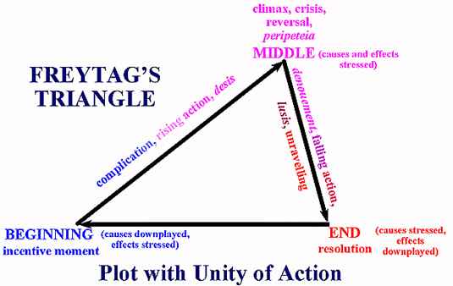
Freytag’s Triangle

Slide 12
Simple vs. Complex plots
Plot can be simple or complex.
Simple plots have only a “change of fortune” (catastrophe). The catastrophe marks the protagonist’s failure and usually occurs at the end of the drama.
Complex plots have both “plot reversal” (peripeteia) and “tragic recognition or insight” (anagnorisis) connected with the catastrophe.

Slide 13
Peripeteia ("plot reversal"): a pivotal or crucial
action on the part of the protagonist that changes his situation from seemingly secure to vulnerable.
Anagnorisis ("tragic recognition or insight"):
according to Aristotle, a moment of clairvoyant insight or understanding in the mind of the tragic hero as he suddenly comprehends the web of fate that he has entangled himself in.

Slide 14
The role of fate
Fate: the supposed force, principle, or power that predetermines events.
The Greeks believed that everything happened for a reason, and that the path they led in life was prescribed for them by the gods: there was no escaping their fate.

Slide 15
2. Characters
The Tragic Hero- The protagonist should be renowned and prosperous, so his change of fortune can be from good to bad.
The tragic hero's powerful wish to achieve some goal inevitably encounters limits, usually those of human frailty (flaws in reason, hubris, society), the gods (through oracles, prophets, fate), or nature.

Slide 16
Hubris ("violent transgression"): overweening pride or insolence that results in a misfortune of the protagonist of the tragedy.
Hubris leads the protagonist to break a moral law; he will attempt vainly to transcend normal limitations or ignore divine warning with calamitous results; placing one's self equal to the gods.
Nemesis ("retribution"): the inevitable punishment or cosmic payback for acts of hubris.

Slide 17
Aristotle says that the tragic hero should have a
flaw and/or make some mistake (harmatia).
The hero need not die at the end, but he/she must
undergo a change in fortune (catastrophe).
In addition, the tragic hero may achieve some
revelation or recognition (anagnorisis) about human fate, destiny, and the will of the gods.

Slide 18
3. Thought
Thought is third in importance, and is found “where something is proved to be or not to be, or a general maxim [truth, principle, or rule of conduct] is enunciated.”
Thought can also reveal the theme (main
idea/message) of a play.

Slide 19
4. Diction
Diction is fourth, and is “the expression of the meaning in words” which are proper and appropriate to the plot, characters, and end of the tragedy.
Metaphor- a figure of speech in which an implied comparison is made between two unlike things that actually have something important in common.
For example: Life is a journey; The eyes are windows to the soul.

Slide 20
5. Song
Song, or melody, is fifth, and is the musical element of the chorus.
Aristotle argues that the Chorus should be fully integrated into the play like an actor; choral odes should not be “mere interludes,” but should contribute to the unity of the plot.

Slide 21
6. Spectacle
Spectacle is last, for it is least connected with literature: spectacular effects depend more on the art of the stage machinist than on that of the poet/author.
Aristotle argues that superior poets rely on the inner structure of the play rather than spectacle to arouse pity and fear.

